Slide 1

File Management
File-System Interface

Slide 2
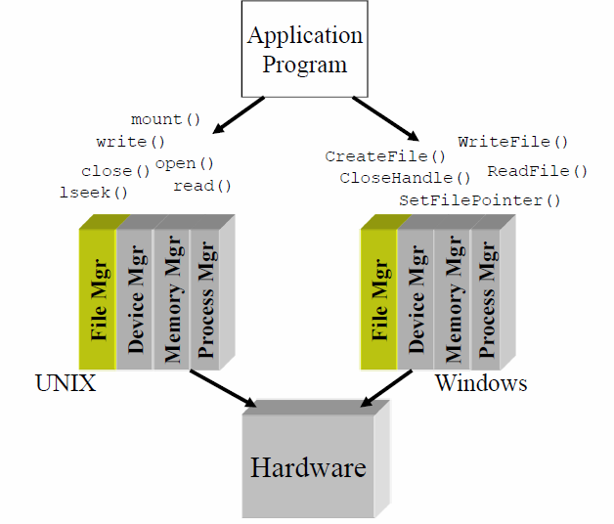

Slide 3
File Management Concepts
Concept of a file
File attributes
File operations
File types
File structure
Access methods
Directory structure
File system mounting
File sharing
File protection
File System structure
File system implementation
Allocation methods
Free space management

Slide 4
File Concept
Uniform logical view of information storage (logical storage unit)
OS maps files onto physical devices
Collection of related information recorded on a secondary storage.
Smallest allotment of secondary storage Types:
Data
numeric
character
binary
Program

Slide 5
File Attributes????

Slide 6
File Attributes
Name – only information kept in human-readable form
Identifier – unique tag (number) identifies file within file system
Type – needed for systems that support different types
Location – pointer to file location on device
Size – current file size
Protection – controls who can do reading, writing, executing
Time, date, and user identification – data for protection, security, and usage monitoring
Information about files are kept in the directory structure, which is maintained on the disk

Slide 7
File Operations
File is an abstract data type
Create
Write
Read
Reposition within file
Delete
Truncate
Open(F_{i}) – search the directory structure on disk for entry F_{i}, and move the content of entry to memory
Close (F_{i}) – move the content of entry F_{i} in memory to directory structure on disk

Slide 8
Open Files
Per-process table
System wide open file table
Several pieces of data are needed to manage open files:
File pointer: pointer to last read/write location, per process that has the file open
File-open count: counter of number of times a file is open – to allow removal of data from open-file table when last processes closes it
Disk location of the file: cache of data access information
Access rights: per-process access mode information

Slide 9
Open File Locking
Provided by some operating systems and file systems
Similar to reader-writer locks
Shared lock similar to reader lock – several processes can acquire concurrently
Exclusive lock similar to writer lock
Mediates access to a file
Mandatory or advisory:
Mandatory – access is denied depending on locks held and requested
Advisory – processes can find status of locks and decide what to do

Slide 10
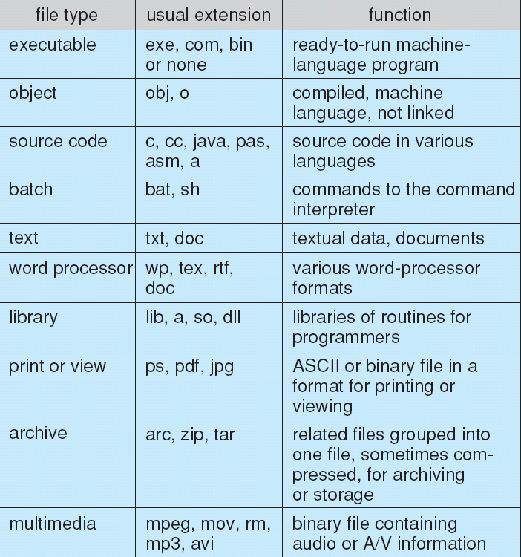
File Types – Name, Extension

Slide 11
File Structure
Types of information stored in a file.
Source programs
Object programs
Executable programs
Numeric data, text, graphic images, sound etc.
File has certain defined structure according to its type

Slide 12
File Structure
None -sequence of words, bytes
Simple record structure
Fixed length
Variable length
Complex Structures
Re-locatable load file

Slide 13
File Structure
Usually two types
Text
Executable
MAC OS
Resource fork
Data fork
Notes:
The resource fork is a construct of the Mac OS operating system used to store structured data in a file, alongside unstructured data stored within the data fork. A resource fork stores information in a specific form, such as icons, the shapes of windows, definitions of menus and their contents, and application code (machine code). For example, a word processing file might store its text in the data fork, while storing any embedded images in the same file's resource fork. The resource fork is used mostly by executables, but every file is able to have a resource fork.

Slide 14
Access Methods
Sequential Access
read next
write next
reset
Direct Access
read n
write n
position to n
read next
write next
rewrite n
n = relative block number

Slide 15
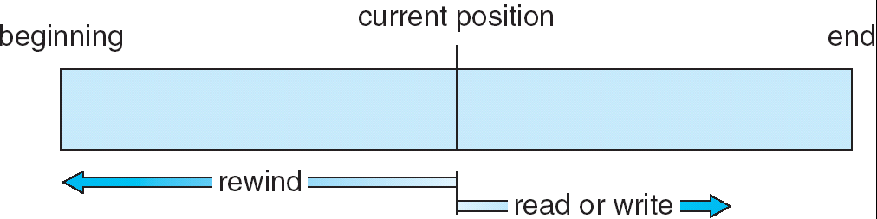
Sequential-access File

Slide 16
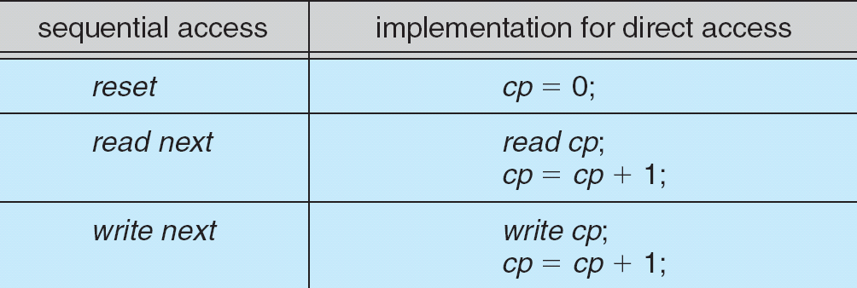
Simulation of Sequential Access on a Direct-access File

Slide 17
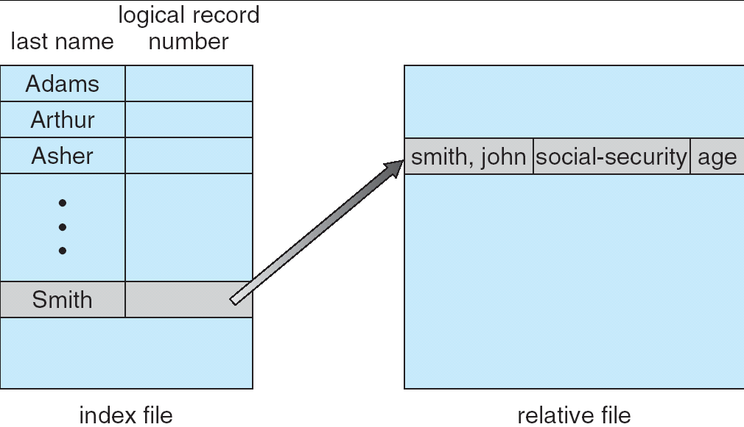
Example of Index and Relative Files

Slide 18
Directory Structure
A collection of nodes containing information about all files
Directory
Files
F 1
F 2
F 3
F 4
F n
Both the directory structure and the files reside on disk
Backups of these two structures are kept on tapes

Slide 19
Disk Structure
Disk can be subdivided into partitions
Disks or partitions can be RAID protected against failure
Disk or partition can be used raw – without a file system, or formatted with a file system
Partitions also known as minidisks, slices

Slide 20
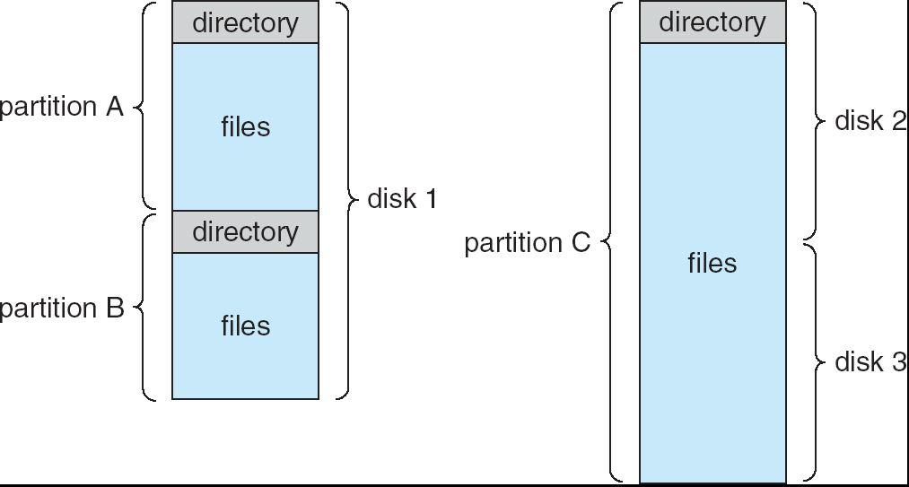
A Typical File-system Organization

Slide 21
Operations Performed on Directory
Search for a file
Create a file
Delete a file
List a directory
Rename a file
Traverse the file system

Slide 22
Directory Organization(Logically)
Efficiency – locating a file quickly
Naming – convenient to users
Two users can have same name for different files
The same file can have several different names
Grouping – logical grouping of files by properties, (e.g., all Java programs, all games, …)

Slide 23
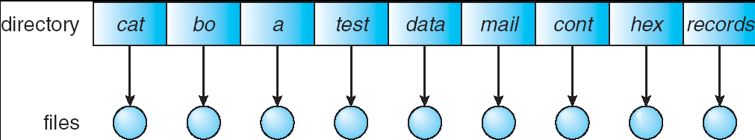
Single-Level Directory
A single directory for all users
Naming problem
Grouping problem

Slide 24
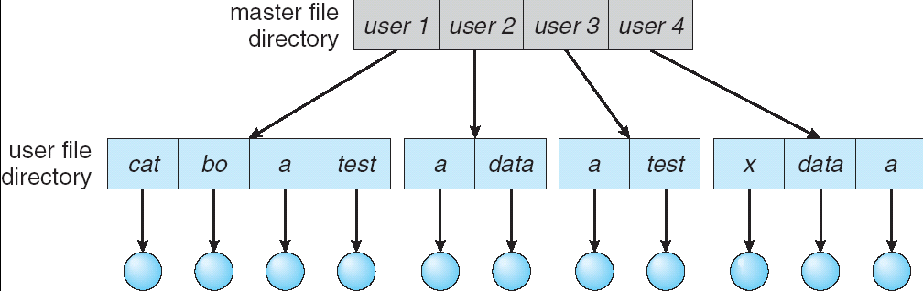
Two-Level Directory
Separate directory for each user
Path name
Can have the same file name for different user
Efficient searching
No grouping capability

Slide 25
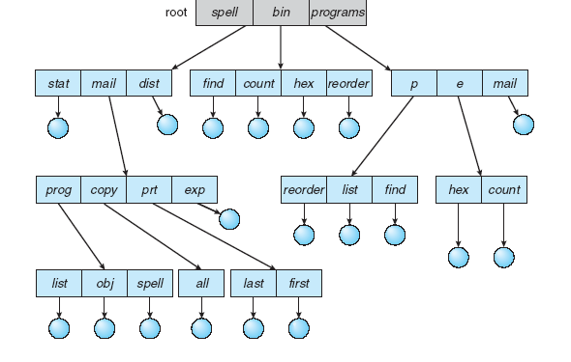
Tree-Structured Directories

Slide 26
Tree-Structured Directories (Cont)
Efficient searching
Grouping Capability
Current directory (working directory)
cd /spell/mail/prog
type list

Slide 27
Tree-Structured Directories
Absolute or relative path name
Creating a new file is done in current directory
Delete a file
rm <file-name>
Creating a new subdirectory is done in current directory
mkdir <dir-name>
Example: if in current directory /mail
mkdir count
mail
prog
copy
prt
exp
count
Deleting “mail” ⇒ deleting the entire subtree rooted by “mail”

Slide 28
Tree-Structured Directories-Advantages
Tree-structure allows each user to create additional subdirectories
allows us to use the current directory as a working directory without the need to specify the whole path name
The deletion of a directory must be recursive to delete all subdirectories and files under the directory

Slide 29
Cons…
None of the above three directory structures enable sharing of files or subdirectories
Adding additional links can result in a general graph or an acyclic graph

Slide 30
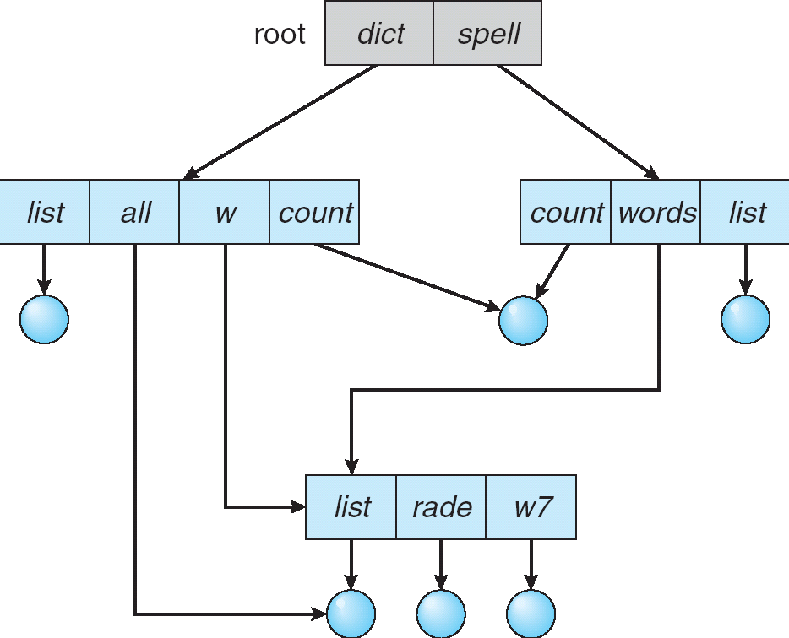
Acyclic-Graph Directories
Have shared subdirectories and files

Slide 31
Acyclic-Graph Directories (Cont.)
Two different names (aliasing)
Dangling pointer
Solutions:
Back pointers, so we can delete all pointers
Entry-hold-count solution
New directory entry type
Link – another name (pointer) to an existing file
Resolve the link – follow pointer to locate the file

Slide 32
Pros & Cons
Acyclic-graph approach enables sharing
The common implementation is to define a "link" as a pointer to another file or subdirectory
The link can be resolved by using the path name. File now can have more than one file names (distinct)

Slide 33
Pros & Cons
The deletion is complicated
since this might leave "dangling links", as the file itself could be deleted, yet the link pointing to it still exists
Or we have to track all the references to a file; unless there is no reference, the file can not be deleted
Notes:
Reference count if reference count is zero delete the file

Slide 34
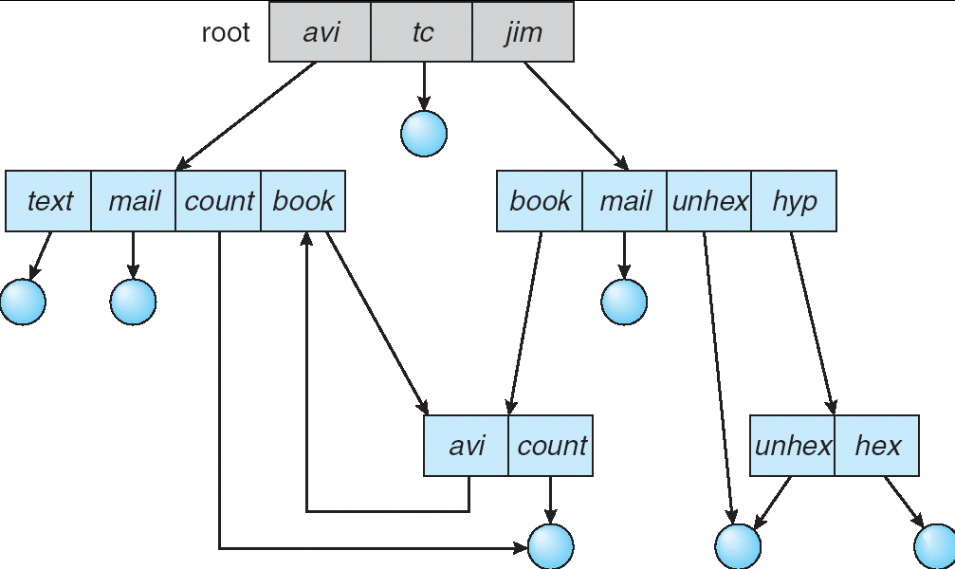
General Graph Directory

Slide 35
General Graph Directory (Cont.)
How do we guarantee no cycles?
Garbage collection
Every time a new link is added use a cycle detection algorithm to determine whether it is OK

Slide 36
Pros & Cons
The main problem is to deal with potential cycles in the directory structure
Garbage collection becomes necessary
extremely time consuming as it need to traverse the entire file system more than once

Slide 37
Pros & Cons
The difficulty with an acyclic-graph is to avoid cycles as new links are added to the directory structure
The algorithms to detect cycles are computationally expensive
when the directory structure is on the disk (not inside the memory)

Slide 38
Pros & Cons
But an acyclic graph is much easier to work with, for example,
easily traverse the directory structure to locate files
to determine when there are no more references to a file (for file deletion)
Both of the above can be tricky in a general graph structure due to the existence of potential cycles

Slide 39
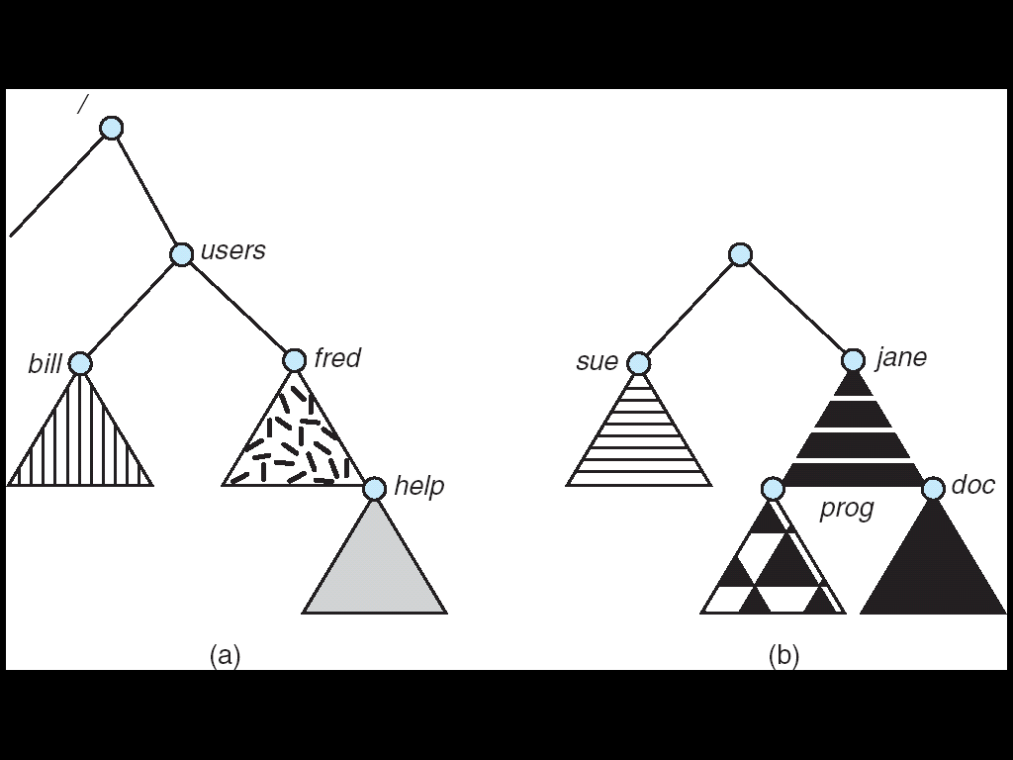
File System Mounting
A file system must be mounted before it can be accessed
A un-mounted file system is mounted at a mount point

Slide 40
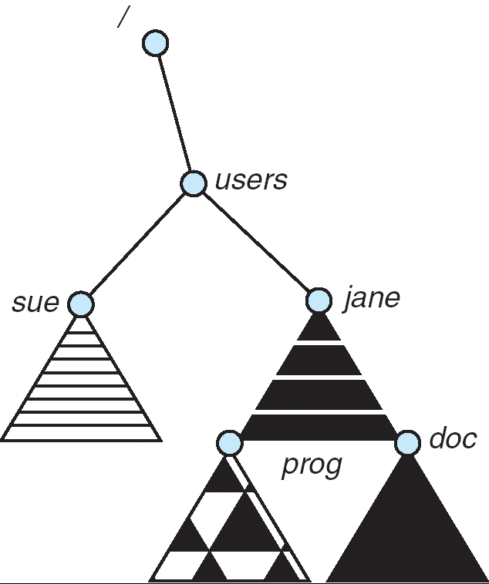
Mount Point

Slide 41
File Sharing
Sharing of files on multi-user systems is desirable
Sharing may be done through a protection scheme
On distributed systems, files may be shared across a network
Network File System (NFS) is a common distributed file-sharing method

Slide 42
File Sharing – Multiple Users
User IDs identify users, allowing permissions and protections to be per-user
Group IDs allow users to be in groups, permitting group access rights

Slide 43
File Sharing – Remote File Systems
Uses networking to allow file system access between systems
Manually via programs like FTP
Automatically, seamlessly using distributed file systems
Client-server model allows clients to mount remote file systems from servers
Server can serve multiple clients
Standard operating system file calls are translated into remote calls

Slide 44
File Sharing – Failure Modes
Remote file systems add new failure modes, due to network failure, server failure
Recovery from failure can involve state information about status of each remote request

Slide 45
Protection
File owner/creator should be able to control:
what can be done
by whom
Types of access
Read
Write
Execute
Append
Delete
List

Slide 46
Access Lists and Groups
Mode of access: read, write, execute
Three classes of users
RWX
a) owner access 7 ⇒ 1 1 1 RWX
b) group access 6 ⇒ 1 1 0
RWX
c) public access 4 ⇒ 100

Slide 47
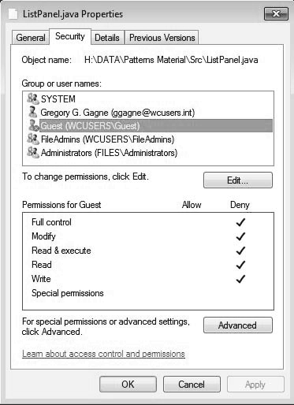
Windows 7 Access-Control List Management

